Slide 4
Notes:
Reference
McClintock SM, et al. A systematic review of the neurocognitive effects of magnetic seizure therapy. Int Rev Psychiatry. 2011;23:413-423.

Slide 7
Notes:
References
1. Hallett M. Transcranial magnetic stimulation: a primer. Neuron. 2007;55:187-199.
2. Noda Y, et al. Neurobiological mechanisms of repetitive transcranial magnetic stimulation of the dorsolateral prefrontal cortex in depression: a systematic review. Psychol Med. 2015;45:3411-3432.
3. McDonald WM, et al. Improving the antidepressant efficacy of transcranial magnetic stimulation: maximizing the number of stimulations and treatment location in treatment-resistant depression. Depress Anxiety. 2011;28:973-980.
4. Carpenter LL, et al. Transcranial magnetic stimulation (TMS) for major depression: a multisite, naturalistic, observational study of acute treatment outcomes in clinical practice. Depress Anxiety. 2012;29:587-596.
5. Silverstein WK, et al. Neurobiological predictors of response to dorsolateral prefrontal cortex repetitive transcranial magnetic stimulation in depression: a systematic review. Depress Anxiety. 2015;32:871-891.

Slide 8
Notes:
References
1. Kedzior KK, et al. More female patients and fewer stimuli per session are associated with the short-term antidepressant properties of repetitive transcranial magnetic stimulation (rTMS): a meta-analysis of 54 sham-controlled studies published between 1997-2013. Neuropsychiatr Dis Treat. 2014;10:727-756.
2. Rossi S, et al. Safety, ethical considerations, and application guidelines for the use of transcranial magnetic stimulation in clinical practice and research. Clin Neurophysiol. 2009;120:2008-2039.
3. Bakker N, et al. rTMS of the dorsomedial prefrontal cortex for major depression: safety, tolerability, effectiveness, and outcome predictors for 10 Hz versus intermittent theta-burst stimulation. Brain Stimul. 2015;8:208-215.

Slide 9
Notes:
Intermittent TBS is excitatory
Continuous TBS is inhibitory

Slide 10
Notes:
References
1. Kedzior KK, et al. More female patients and fewer stimuli per session are associated with the short-term antidepressant properties of repetitive transcranial magnetic stimulation (rTMS): a meta-analysis of 54 sham-controlled studies published between 1997-2013. Neuropsychiatr Dis Treat. 2014;10:727-756.
2. Berlim MT, et al. Response, remission and drop-out rates following high frequency repetitive transcranial magnetic stimulation (rTMS) for treating major depression: a systematic review and metaanalysis of randomized, double-blind and sham-controlled trials. Psychol Med. 2014;44:225-239.
3. Hovington CL, et al. Repetitive transcranial magnetic stimulation (rTMS) for treating major depression and schizophrenia: a systematic review of recent meta-analyses. Ann Med. 2013;45:308-321.
4. Leggett LE, et al. Repetitive transcranial magnetic stimulation for treatment-resistant depression in adult and youth populations: a systematic literature review and metaanalysis. Prim Care Companion CNS Disord. 2015;17(6). doi: 10.4088/PCC.15r01807.
5. McDonald WM, et al. Improving the antidepressant efficacy of transcranial magnetic stimulation: maximizing the number of stimulations and treatment location in treatment-resistant depression. Depress Anxiety. 2011;28:973-980.
6. Fitzgerald PB, et al. A study of the effectiveness of high-frequency left prefrontal cortex transcranial magnetic stimulation in major depression in patients who have not responded to right-sided stimulation. Psychiatry Res. 2009;169:12-15.
7. Chen JJ, et al. Bilateral vs. unilateral repetitive transcranial magnetic stimulation in treating major depression: a meta-analysis of randomized controlled trials. Psychiatry Res. 2014;219:51-57.
8. Berlim MT, et al. A systematic review and meta-analysis on the efficacy and acceptability of bilateral repetitive transcranial magnetic stimulation (rTMS) for treating major depression. Psychol Med. 2013;43:2245-2254.
9. Zhang YQ, et al. Bilateral repetitive transcranial magnetic stimulation for treatment-resistant depression: a systematic review and meta-analysis of randomized controlled trials. Braz J Med Biol Res. 2015;48:198-206.
10. Gaynes BN, et al. Repetitive transcranial magnetic stimulation for treatment-resistant depression: a systematic review and meta-analysis. J Clin Psychiatry. 2014;75:477-489.
11. Health Quality Ontario. Repetitive transcranial magnetic stimulation for treatment-resistant depression: a systematic
review and meta-analysis. Ont Health Technol Assess Ser. 2016;16(5):1-66.
12. Berlim MT, et al. Clinically meaningful efficacy and acceptability of low-frequency repetitive transcranial magnetic stimulation (rTMS) for treating primary major depression: a meta-analysis of randomized, double-blind and sham-controlled trials. Neuropsychopharmacology 2013;38:543-551.
13. Kreuzer PM, et al. The ACDC pilot trial: targeting the anterior cingulate by double cone coil rTMS for the treatment of depression. Brain Stimul. 2015;8:240-246.
14. Salomons TV, et al. Resting-state cortico-thalamic-striatal connectivity predicts response to dorsomedial prefrontal rTMS in major depressive disorder. Neuropsychopharmacology. 2014;39:488-498.
15. Downar J, et al. Anhedonia and reward-circuit connectivity distinguish nonresponders from responders to dorsomedial prefrontal repetitive transcranial magnetic stimulation in major depression. Biol Psychiatry. 2014;76:176-185.
16. Li CT, et al. Efficacy of prefrontal theta burst stimulation in refractory depression: a randomized sham controlled
study. Brain. 2014;137(Pt 7):2088-2098.
17. Chistyakov AV, et al. Preliminary assessment of the therapeutic efficacy of continuous theta burst magnetic stimulation (cTBS) in major depression: a double-blind sham-controlled study. J Affect Disord. 2015;170:225-229.
18. Prasser J, et al. Bilateral prefrontal rTMS and theta burst TMS as an add-on treatment for depression: a randomized placebo controlled trial. World J Biol Psychiatry. 2015;16:57-65.

Slide 11
Notes:
References
1. Cohen RB, et al. Risk factors for relapse after remission with repetitive transcranial magnetic stimulation for the treatment of depression. Depress Anxiety. 2009;26:682-688.
2. Dunner DL, et al. A multisite, naturalistic, observational study of transcranial magnetic stimulation for patients with pharmacoresistant major depressive disorder: durability of benefit over a 1-year follow-up period. J Clin Psychiatry. 2014;75:1394-1401.
3. Janicak PG, et al. Durability of clinical benefit with transcranial magnetic stimulation (TMS) in the treatment of pharmacoresistant major depression: assessment of relapse during a 6-month, multisite, open-label study. Brain Stimul. 2010;3:187-199.
4. Richieri R, et al. Maintenance transcranial magnetic stimulation reduces depression relapse: a propensity adjusted analysis. J Affect Disord. 2013;151:129-135.
5. Fitzgerald PB, et al. An open label trial of clustered maintenance rTMS for patients with refractory depression. Brain Stimul. 2013;6:292-297.

Slide 12
Notes:
References
1. Berlim MT, et al. A systematic review and meta-analysis on the efficacy and acceptability of bilateral repetitive transcranial magnetic stimulation (rTMS) for treating major depression. Psychol Med. 2013;43:2245-2254.
2. Health Quality Ontario. Repetitive transcranial magnetic stimulation for treatment-resistant depression: a systematic review and meta-analysis. Ont Health Technol Assess Ser. 2016;16(5):1-66.
3. Downar J, et al. Anhedonia and reward-circuit connectivity distinguish nonresponders from responders to dorsomedial prefrontal repetitive transcranial magnetic stimulation in major depression. Biol Psychiatry. 2014;76:176-185.
4. Ren J, et al. Repetitive transcranial magnetic stimulation versus electroconvulsive therapy for major depression: a systematic review and meta-analysis. Prog Neuropsychopharmacol Biol Psychiatry. 2014;51:181-189.
5. Xie J, et al. Repetitive transcranial magnetic stimulation versus electroconvulsive therapy for major depression: a meta-analysis of stimulus parameter effects. Neurol Res. 2013;35:1084-1091.
6. Micallef-Trigona B. Comparing the effects of repetitive transcranial magnetic stimulation and electroconvulsive therapy in the treatment of depression: a systematic review and meta-analysis. Depress Res Treat. 2014;2014:135049.

Slide 13
Notes:
References
1. Borckardt JJ, et al. The painfulness of active, but not sham, transcranial magnetic stimulation decreases rapidly over time: results from the double-blind phase of the OPT-TMS Trial. Brain Stimul. 2013;6:925-928.
2. Connolly KR, et al. Effectiveness of transcranial magnetic stimulation in clinical practice post-FDA approval in the United States: results observed with the first 100 consecutive cases of depression at an academic medical center. J Clin Psychiatry. 2012;73:e567-e573.
3. Serafini G, et al. The effects of repetitive transcranial magnetic stimulation on cognitive performance in treatment-resistant depression: a systematic review. Neuropsychobiology. 2015;71:125-139.
4. Dobek CE, et al. Risk of seizures in transcranial magnetic stimulation: a clinical review to inform consent process focused on bupropion. Neuropsychiatr Dis Treat. 2015;11:2975-2987.
5. Rossi S, et al. Safety, ethical considerations, and application guidelines for the use of transcranial magnetic stimulation in clinical practice and research. Clin Neurophysiol. 2009;120:2008-2039.

Slide 14
Notes:
Reference
1. Berlim MT, et al. High-frequency repetitive transcranial magnetic stimulation accelerates and enhances the clinical response to antidepressants in major depression: a meta-analysis of randomized, double-blind, and sham-controlled trials. J Clin Psychiatry. 2013;74:e122-e129.

Slide 15
Notes:
Reference
McClintock SM, et al. A systematic review of the neurocognitive effects of magnetic seizure therapy. Int Rev Psychiatry. 2011;23:413-423.

Slide 18
Notes:
References
1. Brunoni AR, et al. BDNF blood levels after electroconvulsive therapy in patients with mood disorders: a systematic review and meta-analysis. World J Biol Psychiatry. 2014;15:411-418.
2. Verwijk E, et al. Neurocognitive effects after brief pulse and ultrabrief pulse unilateral electroconvulsive therapy for major depression: a review. J Affect Disord. 2012;140:233-243.
3. Loo CK, et al. Speed of response in ultrabrief and brief pulse width right unilateral ECT. Int J Neuropsychopharmacol. 2013;16:755-761.
4. Spaans H, et al. Efficacy of ultrabrief pulse electroconvulsive therapy for depression: a systematic review. J Affect Disord. 2013;150:720-726.
5. Tor P, et al. A systematic review and meta-analysis of brief versus ultrabrief right unilateral electroconvulsive therapy for depression. J Clin Psychiatry. 2015;76:e1092-e1098.

Slide 21
Notes:
References
1. Kellner CH, et al. Bifrontal, bitemporal and right unilateral electrode placement in ECT: randomised trial. Br J Psychiatry. 2010;196:226-234.
2. Heijnen WT, et al. Antidepressant pharmacotherapy failure and response to subsequent electroconvulsive therapy: a meta-analysis. J Clin Psychopharmacol. 2010;30:616-619.
3. Haq AU, et al. Response of depression to electroconvulsive therapy: a meta-analysis of clinical predictors. J Clin Psychiatry. 2015;76:1374-1384.
4. Jelovac A, et al. Relapse following successful electroconvulsive therapy for major depression: a meta-analysis. Neuropsychopharmacology. 2013;38:2467-2474.

Slide 22
Notes:
References
1. Jelovac A, et al. Relapse following successful electroconvulsive therapy for major depression: a meta-analysis. Neuropsychopharmacology. 2013;38:2467-2474.
2. Sackeim HA, et al. Continuation pharmacotherapy in the prevention of relapse following electroconvulsive therapy: a randomized controlled trial. JAMA. 2001;285:1299-1307.
3. Prudic J, et al. Pharmacological strategies in the prevention of relapse after electroconvulsive therapy. J ECT. 2013;29:3-12.
4. Petrides G, et al. Continuation and maintenance electroconvulsive therapy for mood disorders: review of the literature. Neuropsychobiology. 2011;64:129-140.
5. van Schaik AM, et al. Efficacy and safety of continuation and maintenance electroconvulsive therapy in depressed elderly patients: a systematic review. Am J Geriatr Psychiatry. 2012;20:5-17.
6. Kellner CH, et al. Continuation electroconvulsive therapy vs pharmacotherapy for relapse prevention in major depression: a multisite study from the Consortium for Research in Electroconvulsive Therapy (CORE). Arch Gen Psychiatry. 2006;63:1337-1344.
7. McClintock SM, et al. A systematic review of the combined use of electroconvulsive therapy and psychotherapy for depression. J ECT. 2011;
27:236-243.
8. Brakemeier EL, et al. Cognitive-behavioral therapy as continuation treatment to sustain response after electroconvulsive therapy in depression: a randomized controlled trial. Biol Psychiatry. 2014;76:194-202.

Slide 23
Notes:
References
1. Watts BV, et al. An examination of mortality and other adverse events related to electroconvulsive therapy using a national adverse event report system. J ECT. 2011;27:105-108.
2. Kumar S, et al. Systematic review of cognitive effects of electroconvulsive therapy in late-life depression. Am J Geriatr Psychiatry. 2016 Mar 8. [Epub ahead of print]
3. Semkovska M, McLoughlin DM. Objective cognitive performance associated with electroconvulsive therapy for depression: a systematic review and meta-analysis. Biol Psychiatry. 2010;68:568-577.
4. Fraser LM, et al. The effect of electroconvulsive therapy on autobiographical memory: a systematic review. J ECT. 2008;24:10-17.
5. Fernie G, et al. Detecting objective and subjective cognitive effects of electroconvulsive therapy: intensity, duration and test utility in a large clinical sample. Psychol Med. 2014;44:2985-2994.

Slide 25
Notes:
References
1. Jelovac A, et al. Relapse following successful electroconvulsive therapy for major depression: a meta-analysis. Neuropsychopharmacology. 2013;38:2467-2474.
2. Sienaert P, Peuskens J. Anticonvulsants during electroconvulsive therapy: review and recommendations. J ECT. 2007;23:120-123.

Slide 26
Notes:
Reference
McClintock SM, et al. A systematic review of the neurocognitive effects of magnetic seizure therapy. Int Rev Psychiatry. 2011;23:413-423.

Slide 29
Notes:
Reference
Stagg CJ, Nitsche MA. Physiological basis of transcranial direct current stimulation. Neuroscientist. 2011;17:37-53.

Slide 30
Notes:
References
1. Meron D, et al. Transcranial direct current stimulation (tDCS) in the treatment of depression: systematic review and meta-analysis of efficacy and tolerability. Neurosci Biobehav Rev. 2015;57:46-62.
2. Shiozawa P, et al. Transcranial direct current stimulation for major depression: an updated systematic review and meta-analysis. Int J Neuropsychopharmacol. 2014;17:1443-1452.
3. Brunoni AR, Valiengo L, Baccaro A, et al. The sertraline vs. electrical current therapy for treating depression clinical study:
results from a factorial, randomized, controlled trial. JAMA Psychiatry. 2013;70:383-391.
4. Nitsche MA, et al. Serotonin affects transcranial direct current-induced neuroplasticity in humans.
Biol Psychiatry. 2009;66:503-508.
5. Brunoni AR, et al. Cognitive control therapy and transcranial direct current stimulation for depression: a randomized, double-blinded, controlled trial. J Affect Disord. 2014;162:43-49.

Slide 31
Notes:
References
1. Meron D, et al. Transcranial direct current stimulation (tDCS) in the treatment of depression: systematic review and meta-analysis of efficacy and tolerability. Neurosci Biobehav Rev. 2015;57:46-62.
2. Shiozawa P. Transcranial direct current stimulation for major depression: an updated systematic review and meta-analysis. Int J Neuropsychopharmacol. 2014;17:1443-1452.
3. Berlim MT, et al. Clinical utility of transcranial direct current stimulation (tDCS) for treating major depression: a systematic review and meta-analysis of randomized, double-blind and sham-controlled trials. J Psychiatr Res. 2013;47:1-7.
4. Brunoni AR, et al. Transcranial direct current stimulation for acute major depressive episodes: meta-analysis of individual patient data. Br J Psychiatry. 2016 Apr 7. [Epub ahead of print].

Slide 32
Notes:
References
1. Meron D, et al. Transcranial direct current stimulation (tDCS) in the treatment of depression: systematic review and meta-analysis of efficacy and tolerability. Neurosci Biobehav Rev. 2015;57:46-62.
2. Shiozawa P, et al. Transcranial direct current stimulation for major depression: an updated systematic review and meta-analysis. Int J Neuropsychopharmacol. 2014;17:1443-1452.
3. Brunoni AR, et al. The sertraline vs. electrical current therapy for treating depression clinical study: results from a factorial, randomized, controlled trial. JAMA Psychiatry. 2013;70:383-391.

Slide 36
Notes:
Reference
Nemeroff CB, et al. VNS therapy in treatment-resistant depression: clinical evidence and putative neurobiological mechanisms. Neuropsychopharmacology. 2006;31:1345-1355.

Slide 37
Notes:
Reference
Aaronson ST, et al. Vagus nerve stimulation therapy randomized to different amounts of electrical charge for treatment-resistant depression: acute and chronic effects. Brain Stimul. 2013;6:631-640.

Slide 38
Notes:
References
1. Martin JL, Martin-Sanchez E. Systematic review and meta-analysis of vagus nerve stimulation in the treatment of depression: variable results based on study designs. Eur Psychiatry. 2012;27:147-155.
2. Rush AJ, et al. Vagus nerve stimulation for treatment-resistant depression: a randomized, controlled acute phase trial. Biol Psychiatry. 2005;58:
347-354.

Slide 39
Notes:
References
1. Berry SM, et al. A patient-level meta-analysis of studies evaluating vagus nerve stimulation therapy for treatment-resistant depression. Med Devices (Auckl). 2013;6:17-35.
2. Schlaepfer TE, et al. Vagus nerve stimulation for depression: efficacy and safety in a European study. Psychol Med. 2008;38:651-661.
3. Bajbouj M, et al. Two-year outcome of vagus nerve stimulation in treatment-resistant depression. J Clin Psychopharmacol. 2010;30:273-281.

Slide 40
Notes:
References
1. Aaronson ST, et al. Vagus nerve stimulation therapy randomized to different amounts of electrical charge for treatment-resistant depression: acute and chronic effects. Brain Stimul. 2013;6:631-640.
2. Berry SM, et al. A patient-level meta-analysis of studies evaluating vagus nerve stimulation therapy for treatment-resistant depression. Med Devices (Auckl). 2013;6:17-35.
3. Olin B, et al. Mortality and suicide risk in treatment-resistant depression: an observational study of the long-term impact of intervention. PLoS One. 2012;7:e48002.

Slide 41
Notes:
Reference
McClintock SM, et al. A systematic review of the neurocognitive effects of magnetic seizure therapy. Int Rev Psychiatry. 2011;23:413-423.

Slide 44
Notes:
Reference
Nemeroff CB, et al. VNS therapy in treatment-resistant depression: clinical evidence and putative neurobiological mechanisms. Neuropsychopharmacology. 2006;31:1345-1355.

Slide 45
Notes:
References
1. Morishita T, et al. Deep brain stimulation for treatment-resistant depression: systematic review of clinical outcomes. Neurotherapeutics. 2014;11:475-484.
2. Berlim MT, et al. Effectiveness and acceptability of deep brain stimulation (DBS) of the subgenual cingulate cortex for treatment-resistant depression: a systematic review and exploratory meta-analysis. J Affect Disord. 2014;159:31-38.
3. Dougherty DD, et al. A randomized sham-controlled trial of deep brain stimulation of the ventral capsule/ventral striatum for chronic treatment-resistant depression. Biol Psychiatry. 2015;78:240-248.
4. Schlaepfer TE, et al. Rapid effects of deep brain stimulation for treatment-resistant major depression. Biol Psychiatry. 2013;73:1204-1212.

Slide 46
Notes:
References
1. Berlim MT, et al. Effectiveness and acceptability of deep brain stimulation (DBS) of the subgenual cingulate cortex for treatment-resistant depression: a systematic review and exploratory meta-analysis. J Affect Disord. 2014;159:31-38.
2. Holtzheimer PE, et al. Subcallosal cingulate deep brain stimulation for treatment-resistant unipolar and bipolar depression. Arch Gen Psychiatry. 2012;69:150-158.
3. Kennedy SH, et al. Deep brain stimulation for treatment-resistant depression: follow-up after 3 to 6 years. Am J Psychiatry. 2011;168:502-510.
4. Schlaepfer TE, Bewernick BH. Deep brain stimulation for major depression. Handb Clin Neurol. 2013;116:235-243.

Slide 47
Notes:
Reference
Puigdemont D, et al. A randomized double-blind crossover trial of deep brain stimulation of the subcallosal cingulate gyrus in patients with treatment-resistant depression: a pilot study of relapse prevention. J Psychiatry Neurosci. 2015;40:224-231.

Slide 48
Notes:
References
1. Berlim MT, et al. Effectiveness and acceptability of deep brain stimulation (DBS) of the subgenual cingulate cortex for treatment-resistant depression: a systematic review and exploratory meta-analysis. J Affect Disord. 2014;159:31-38.
2. Holtzheimer PE, et al. Subcallosal cingulate deep brain stimulation for treatment-resistant unipolar and bipolar depression. Arch Gen Psychiatry. 2012;69:150-158.
3. Kennedy SH, et al. Deep brain stimulation for treatment-resistant depression: follow-up after 3 to 6 years. Am J Psychiatry. 2011;168:502-510.
4. Schlaepfer TE, Bewernick BH. Deep brain stimulation for major depression. Handb Clin Neurol. 2013;116:235-243.
5. Bogod NM, et al. Long-term neuropsychological safety of subgenual cingulate gyrus deep brain stimulation for treatment-resistant depression. J Neuropsychiatry Clin Neurosci. 2014;26:126-133.
6. Grubert C, et al. Neuropsychological safety of nucleus accumbens deep brain stimulation for major depression: effects of 12-month stimulation. World J Biol Psychiatry. 2011;12:516-527.
7. Moreines JL, et al. Neuropsychological function before and after subcallosal cingulate deep brain stimulation in patients with treatment-resistant depression. Depress Anxiety. 2014;31:690-698.
8. Bewernick BH, et al. Nucleus accumbens deep brain stimulation decreases ratings of depression and anxiety in treatment-resistant depression. Biol Psychiatry. 2010;67:110-116.

Slide 50
Notes:
Reference
McClintock SM, et al. A systematic review of the neurocognitive effects of magnetic seizure therapy. Int Rev Psychiatry. 2011;23:413-423.

Slide 53
Notes:
Reference
McClintock SM, et al. A systematic review of the neurocognitive effects of magnetic seizure therapy. Int Rev Psychiatry. 2011;23:413-423.

Slide 55
Notes:
References
1. Kayser S, et al. Antidepressant effects, of magnetic seizure therapy and electroconvulsive therapy, in treatment-resistant depression. J Psychiatr Res. 2011;45:569-576.
2. Kayser S, et al. Magnetic seizure therapy in treatment-resistant depression: clinical, neuropsychological and metabolic effects. Psychol Med. 2015;45:1073-1092.

Slide 56
Notes:
References
1. McClintock SM, et al. A systematic review of the neurocognitive effects of magnetic seizure therapy. Int Rev Psychiatry. 2011;23:413-423.
2. Kayser S, et al. Antidepressant effects, of magnetic seizure therapy and electroconvulsive therapy, in treatment-resistant depression. J Psychiatr Res. 2011;45:569-576.

Slide 59
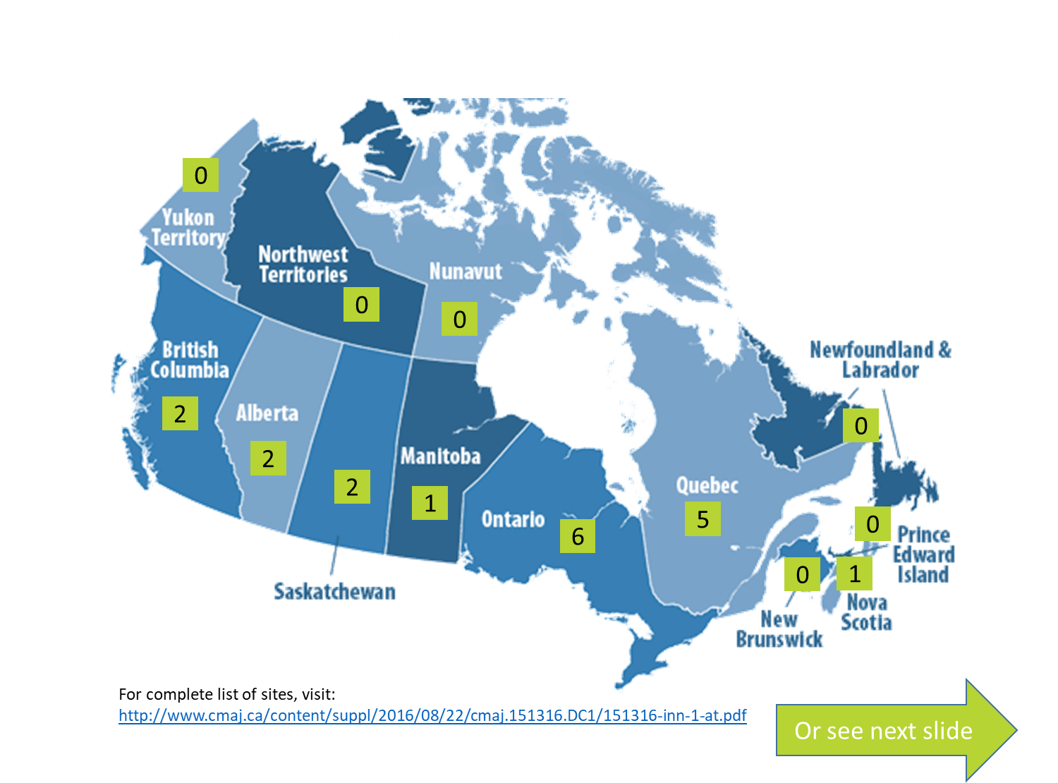

Slide 60
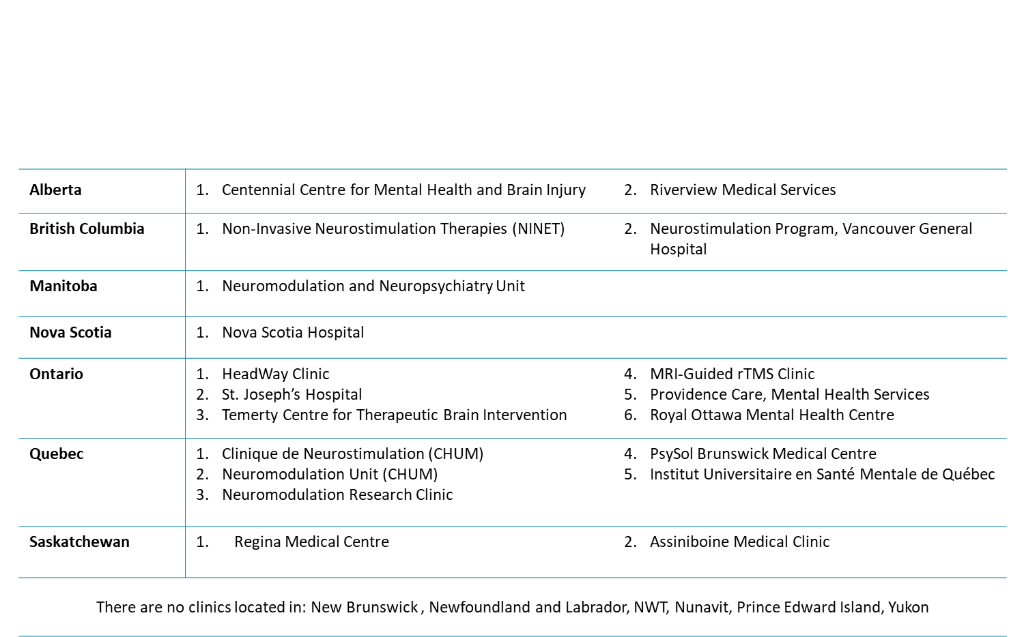

Slide 61
