Slide 3
Contents

Slide 4
Prevalence of Bipolar Disorder

Slide 5
Age of onset

Slide 6
Long Term Morbidity in BD*

Slide 7
Qualify of Life and Functional Impairment

Slide 8
Global Burden of Disease

Slide 9
Spectrum of Bipolar Disorder

Slide 10
Bipolar and Related Disorders: DSM-5 Diagnostic Features

Slide 11
Bipolar and Related Disorders: DSM-5 Diagnostic Features

Slide 12
Bipolar and Related Disorders: DSM-5 Diagnostic Features

Slide 13
Bipolar and Related Disorders: DSM-5 Diagnostic Features

Slide 14
Bipolar and Related Disorders: DSM-5 Diagnostic Features

Slide 15
Bipolar and Related Disorders: DSM-5 Diagnostic Features

Slide 16
Bipolar and Related Disorders: DSM-5 Diagnostic Features

Slide 17
DSM-5 Specifiers for Bipolar and Related Disorders

Slide 18
Course of Bipolar Disorder

Slide 19
Staging Bipolar Disorder

Slide 20
Misdiagnosis of Bipolar Disorder

Slide 21
Diagnostic Assessment: Screening and Diagnosis of Bipolar Disorder

Slide 22
Features of Depression that May Increase Suspicion of a Bipolar vs Unipolar Illness

Slide 23
Screening Tools

Slide 24
Diagnostic Considerations

Slide 25
Comorbidities and Mimics

Slide 26
Differential Diagnosis of Bipolar Disorder

Slide 27
Differential Diagnosis of Bipolar Disorder Cont.

Slide 28
Suicide Risk is Substantially Higher in Bipolar Disorder than the General Population

Slide 29
Assessing Suicide Risk

Slide 30
Summary of Main Factors associated with Suicide Attempt and Suicide Deaths in Bipolar Disorder

Slide 31
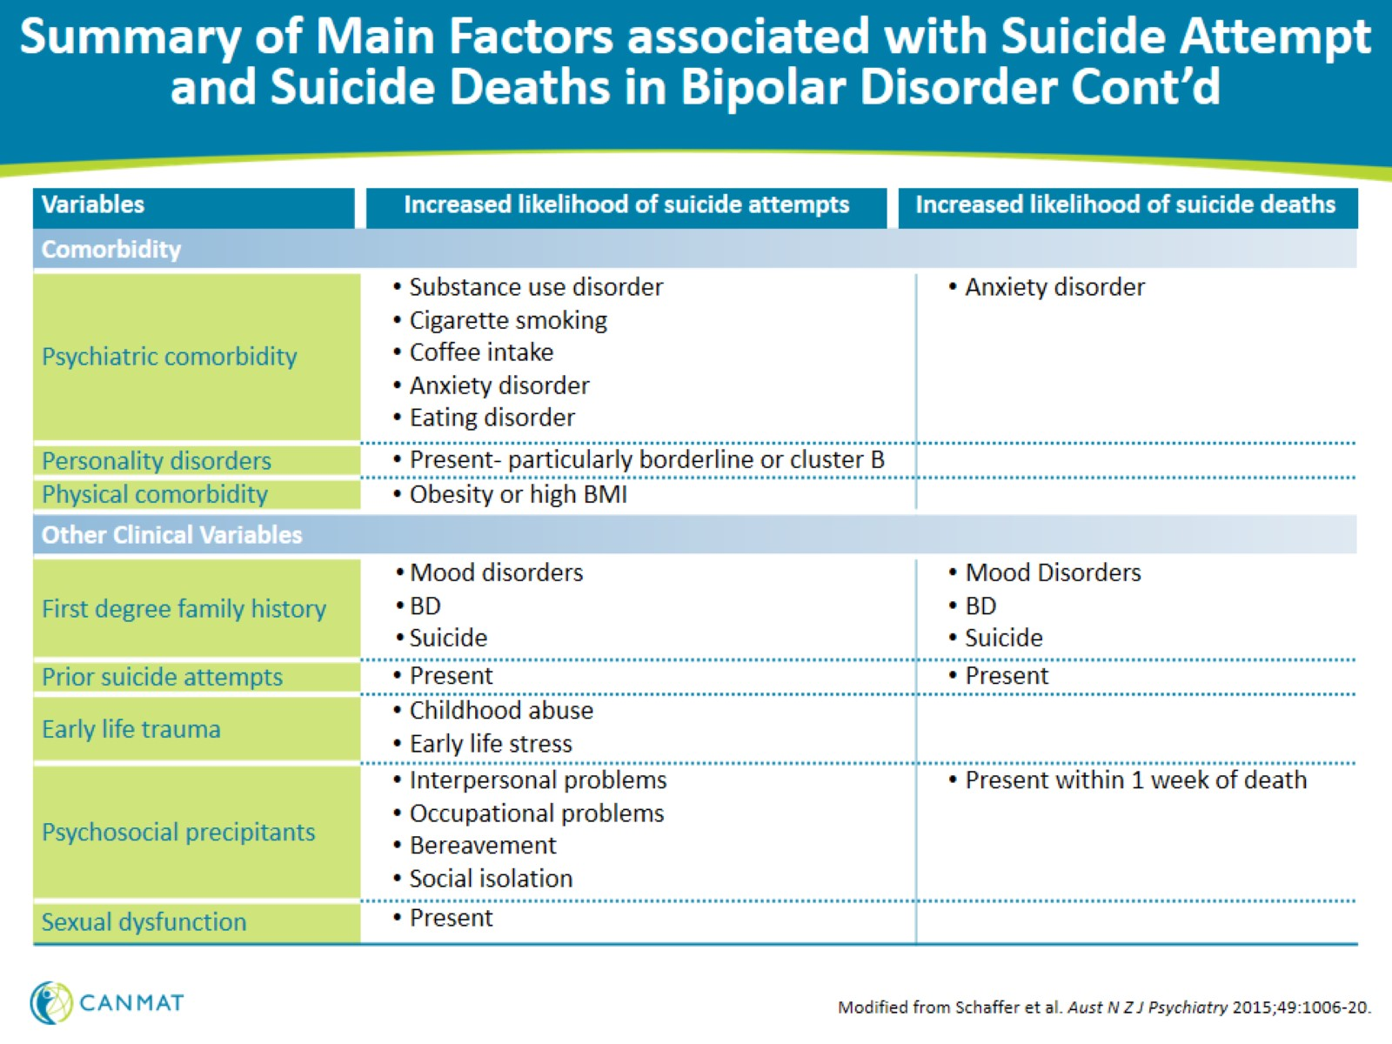
Summary of Main Factors associated with Suicide Attempt and Suicide Deaths in Bipolar Disorder Cont’d

Slide 32
Chronic Disease Management Model

Slide 33
The Chronic Disease Management Model

Slide 34
The Chronic Disease Management Model Cont.

Slide 35
Self-Management Support Tools

Slide 36
Stigma

Slide 37
Psychosocial Interventions

Slide 38
Strength of Evidence and Recommendations for Adjunctive Psychological Treatments for Bipolar Disorder

Slide 39
Psychoeducation

Slide 40
Cognitive Behavioural Therapy (CBT)

Slide 41
Family Focused Therapy (FFT)

Slide 42
Interpersonal and Social Rhythm Therapy (IPSRT)

Slide 43
Peer Interventions

Slide 44
Other Psychosocial Interventions

Slide 45
Cognitive and Functional Remediation

Slide 46
Online and Digital Strategies

